Slide 1
Lighting Integration with
protocol KNX/DALI

Slide 2
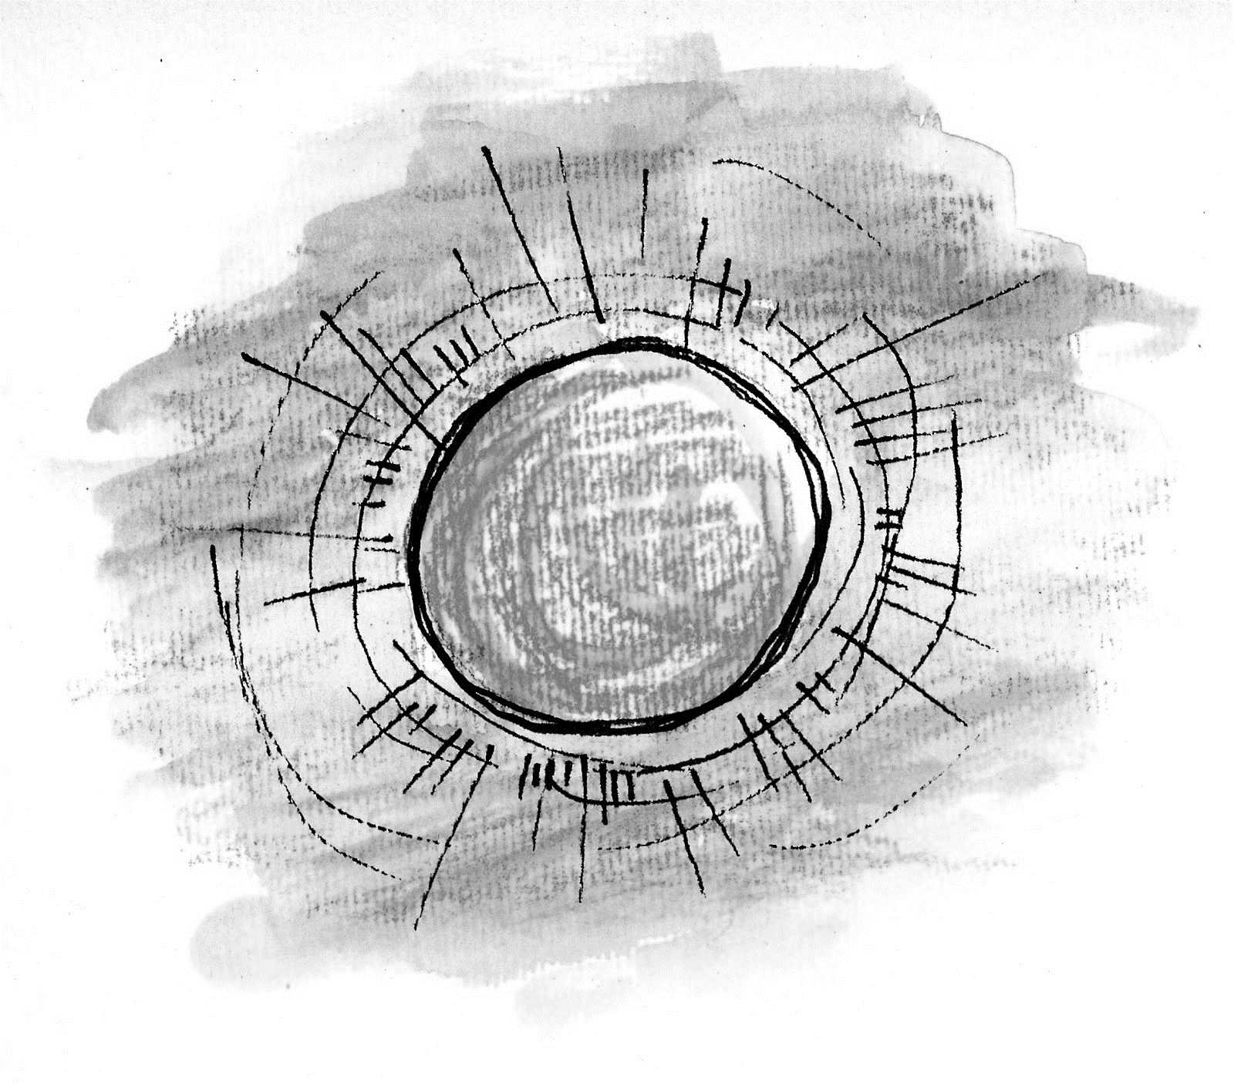
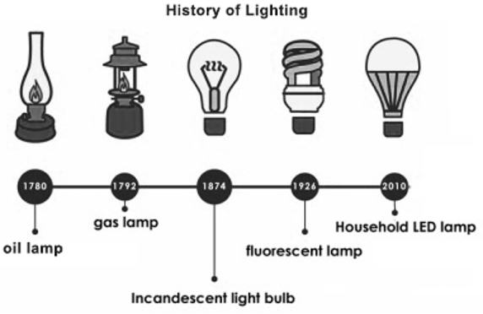
Lighting Control KNX/Dali
Light Evolution
Sunlight
free
sustainable
bodies primed
Natural Light
Artificial Light
light
heating
cooking
EKINEX CONFIDENTIAL AND PROPRIETARY | ©2023 Ekinex S.p.A.
Notes:
Before there was light, well, before there was artificial light, we had sunlight. It was free, sustainable, and our bodies were primed by it.
But at night, it was a different story. We were vulnerable to predators, found it difficult to stay warm, and were more susceptible to foodborne disease.
Thankfully, our hunter–gatherer ancestors discovered fire. Fire fended off predators, gave us warmth and comfort, and expanded our menu with the introduction of cooking.
But as we evolved, we wanted to stay up way past our bedtimes, so we invented artificial light.
At first, artificial light started out as a luxury, and like most luxuries it was expensive.
1750 BC = 1 hour light = 50 hours of work.
1800 = 1 hour light = 6 hours of work
1880 = 1 hour light = 15 minutes of work
1950 = 1 hour light = 8 second of work (Edison light bulb)
Today = 1 hour light = 0,5 seconds of work.

Slide 3
Lighting Control KNX/Dali
Light Evolution
Beside light evolution there was also a Tecnology Evolution
LED sources
artificial light design is changing gradually
Digitalization
command/control
new solutions
EKINEX CONFIDENTIAL AND PROPRIETARY | ©2023 Ekinex S.p.A.

Slide 4
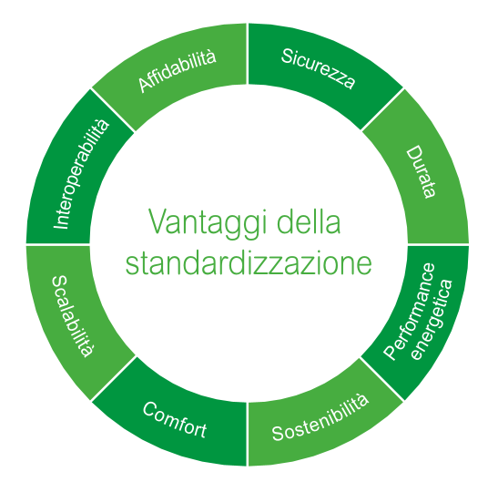
Lighting Control KNX/Dali
Standard
Suitability for the use for which it is intended, guaranteeing all applicable standards (e.g. safety)
Reliability
Safety
Guarantee of interchangeability of the elements that constitute it (mechanical aspects and performance)
Interoperability
Duration
Certification, Demonstration and Verification of performance
Standard
Advantages
Scalability
Energy
performance
Standard represents a guarantee for all market operators:
Designers
Installers
End users
Comfort
Sustainability
EKINEX CONFIDENTIAL AND PROPRIETARY | ©2023 Ekinex S.p.A.

Slide 5
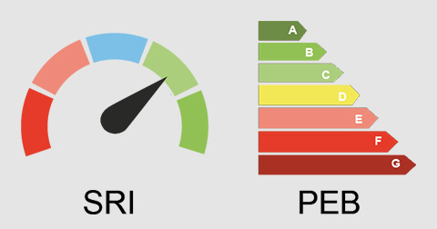
Lighting Control KNX/Dali
SRI Indicator
SRI
Smart Readiness Indicator
Directive 2018/844/EU
Ability of a Building and its technological systems to detect, interpret, communicate and respond actively, efficiently, to the various modifications due to:
Operations
Extenal conditions
Energy networks
Needs
EKINEX CONFIDENTIAL AND PROPRIETARY | ©2023 Ekinex S.p.A.

Slide 6
Lighting Control KNX/Dali
Energy performance
Termoregulation
Sanitary Hot Water
Ventilation
Lighting
Consumption
40%
BACS | TBM high performance
A
BACS | TBM advanced
B
BAC Building Automation and Control
Set of products, systems, services and monitoring or optimization activities intended for energy efficiency
BACS standard
C
BACS not efficient
D
BACS Building Automation and Control System
BAC system designed, built and managed to improve energy efficiency
TBM Technical Building Management
Set of processes and services for the operation, maintenance and control of technical systems to check their efficiency
EKINEX CONFIDENTIAL AND PROPRIETARY | ©2023 Ekinex S.p.A.

Slide 7
Lighting Control KNX/Dali
Lighting Control
 |  |  | Classi
 |  |  | Residenziale |  |  |  | Non Residenziale
 |  |  | D | C | B | A | D | C | B | A
5 | Lighting Control
5.1 | Presence control
 | 0 | Manual on/off command
 | 1 | Manual on/off command with additional off indication
 | 2 | Automatic detection (automatic switching)
 | 3 | Automatic detection (manual switching)
5.2 | Control based on natural light
 | 0 | Centralized manual command
 | 1 | Eviroment/Zone manual command
 | 2 | Automatic on/off
 | 3 | Automatic control with continous regulation (dimming)
D
C
B
-15%
-23%
A
B
C
D
EKINEX CONFIDENTIAL AND PROPRIETARY | ©2023 Ekinex S.p.A.

Slide 8
Lighting Control KNX/Dali
Energy performance
Expenditure Factor
Requested energy
Expenditure Factor
Energy consumed by ideal installation
(theoretical)
$e_{L}=e_{L,C}∙e_{L,O}∙e_{L,D}$ $∙e_{L,ES}$
$$e_{L,C}$$
Consatnt light control
The first 3 factors are related to the technological control and regulation solution of the system.
Last factor is related to lighting devices features and their efficiency.
$$e_{L,O}$$
Presence detection
$$e_{L,D}$$
Natural light control
$$e_{L,ES}$$
Installed power density
EKINEX CONFIDENTIAL AND PROPRIETARY | ©2023 Ekinex S.p.A.

Slide 9
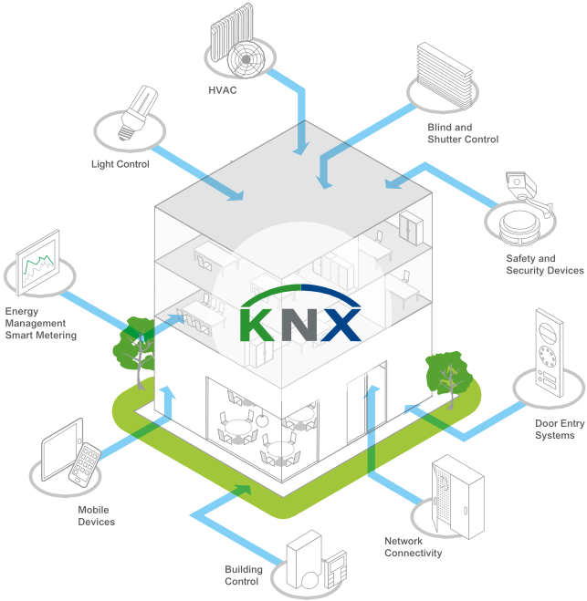
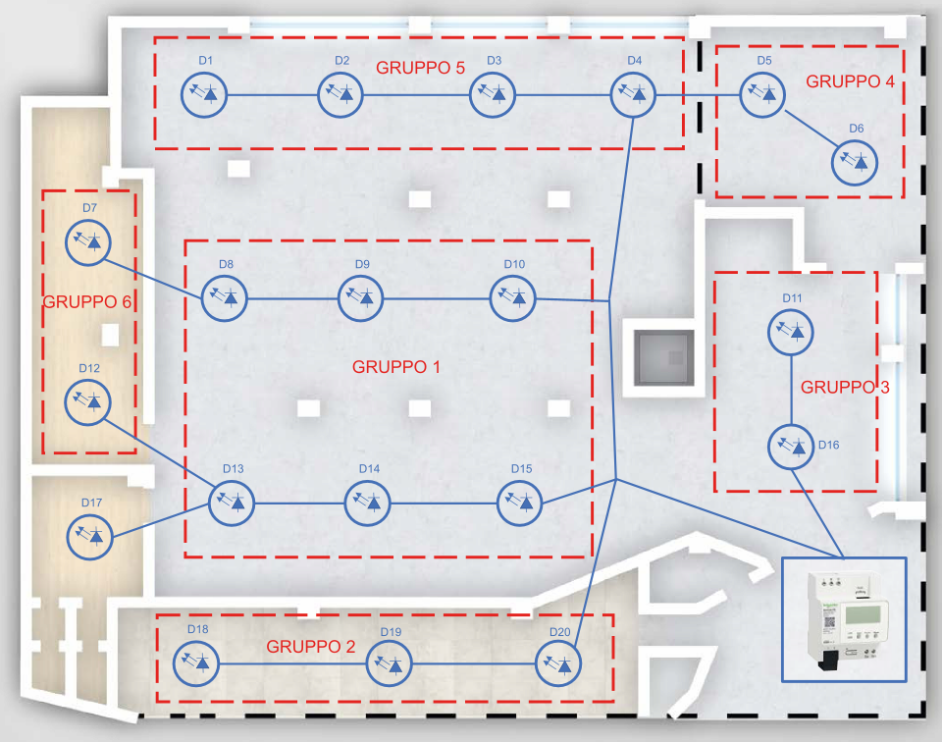
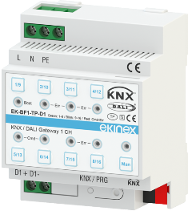
Lighting Control KNX/Dali
Digital installation
EKINEX CONFIDENTIAL AND PROPRIETARY | ©2023 Ekinex S.p.A.

Slide 10
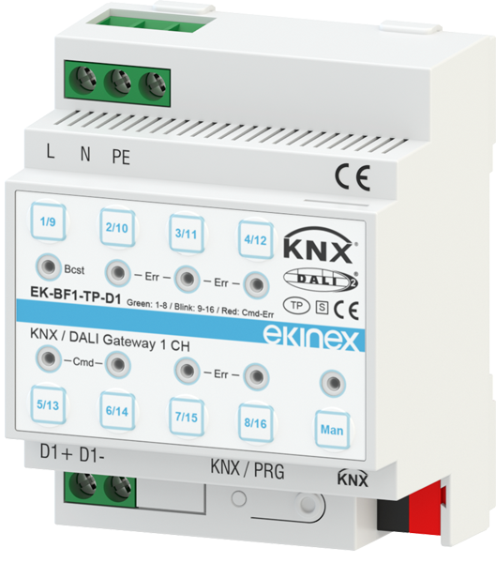
Lighting Control KNX/Dali
Digital installation
Gateway
KNX/Dali
EKINEX CONFIDENTIAL AND PROPRIETARY | ©2023 Ekinex S.p.A.

Slide 11
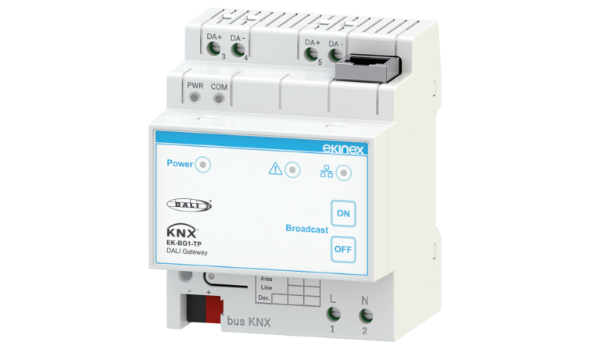
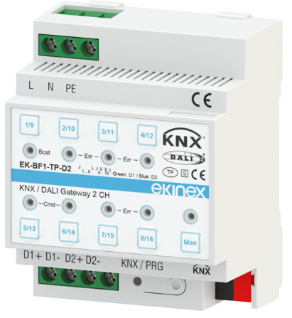
Lighting Control KNX/Dali
Gateway KNX/Dali
EK-BG1-TP
EK-BF1-TP-D1
EK-BF1-TP-D2
KNX Certification
DALI2 Certification
1-channel DALI
Driver DT6 supported
Driver DT8 supported
(no RGBW)
Commissioning DALI with Windows Application
KNX Certification
DALI2 Certification
1-channel DALI
Driver DT6 supported
Driver DT8 supported
Commissioning DALI with ETS (DCA)
KNX Certification
DALI2 Certification
2-channels DALI
Driver DT6 supported
Driver DT8 supported
Commissioning DALI with ETS (DCA)
EKINEX CONFIDENTIAL AND PROPRIETARY | ©2023 Ekinex S.p.A.

Slide 12
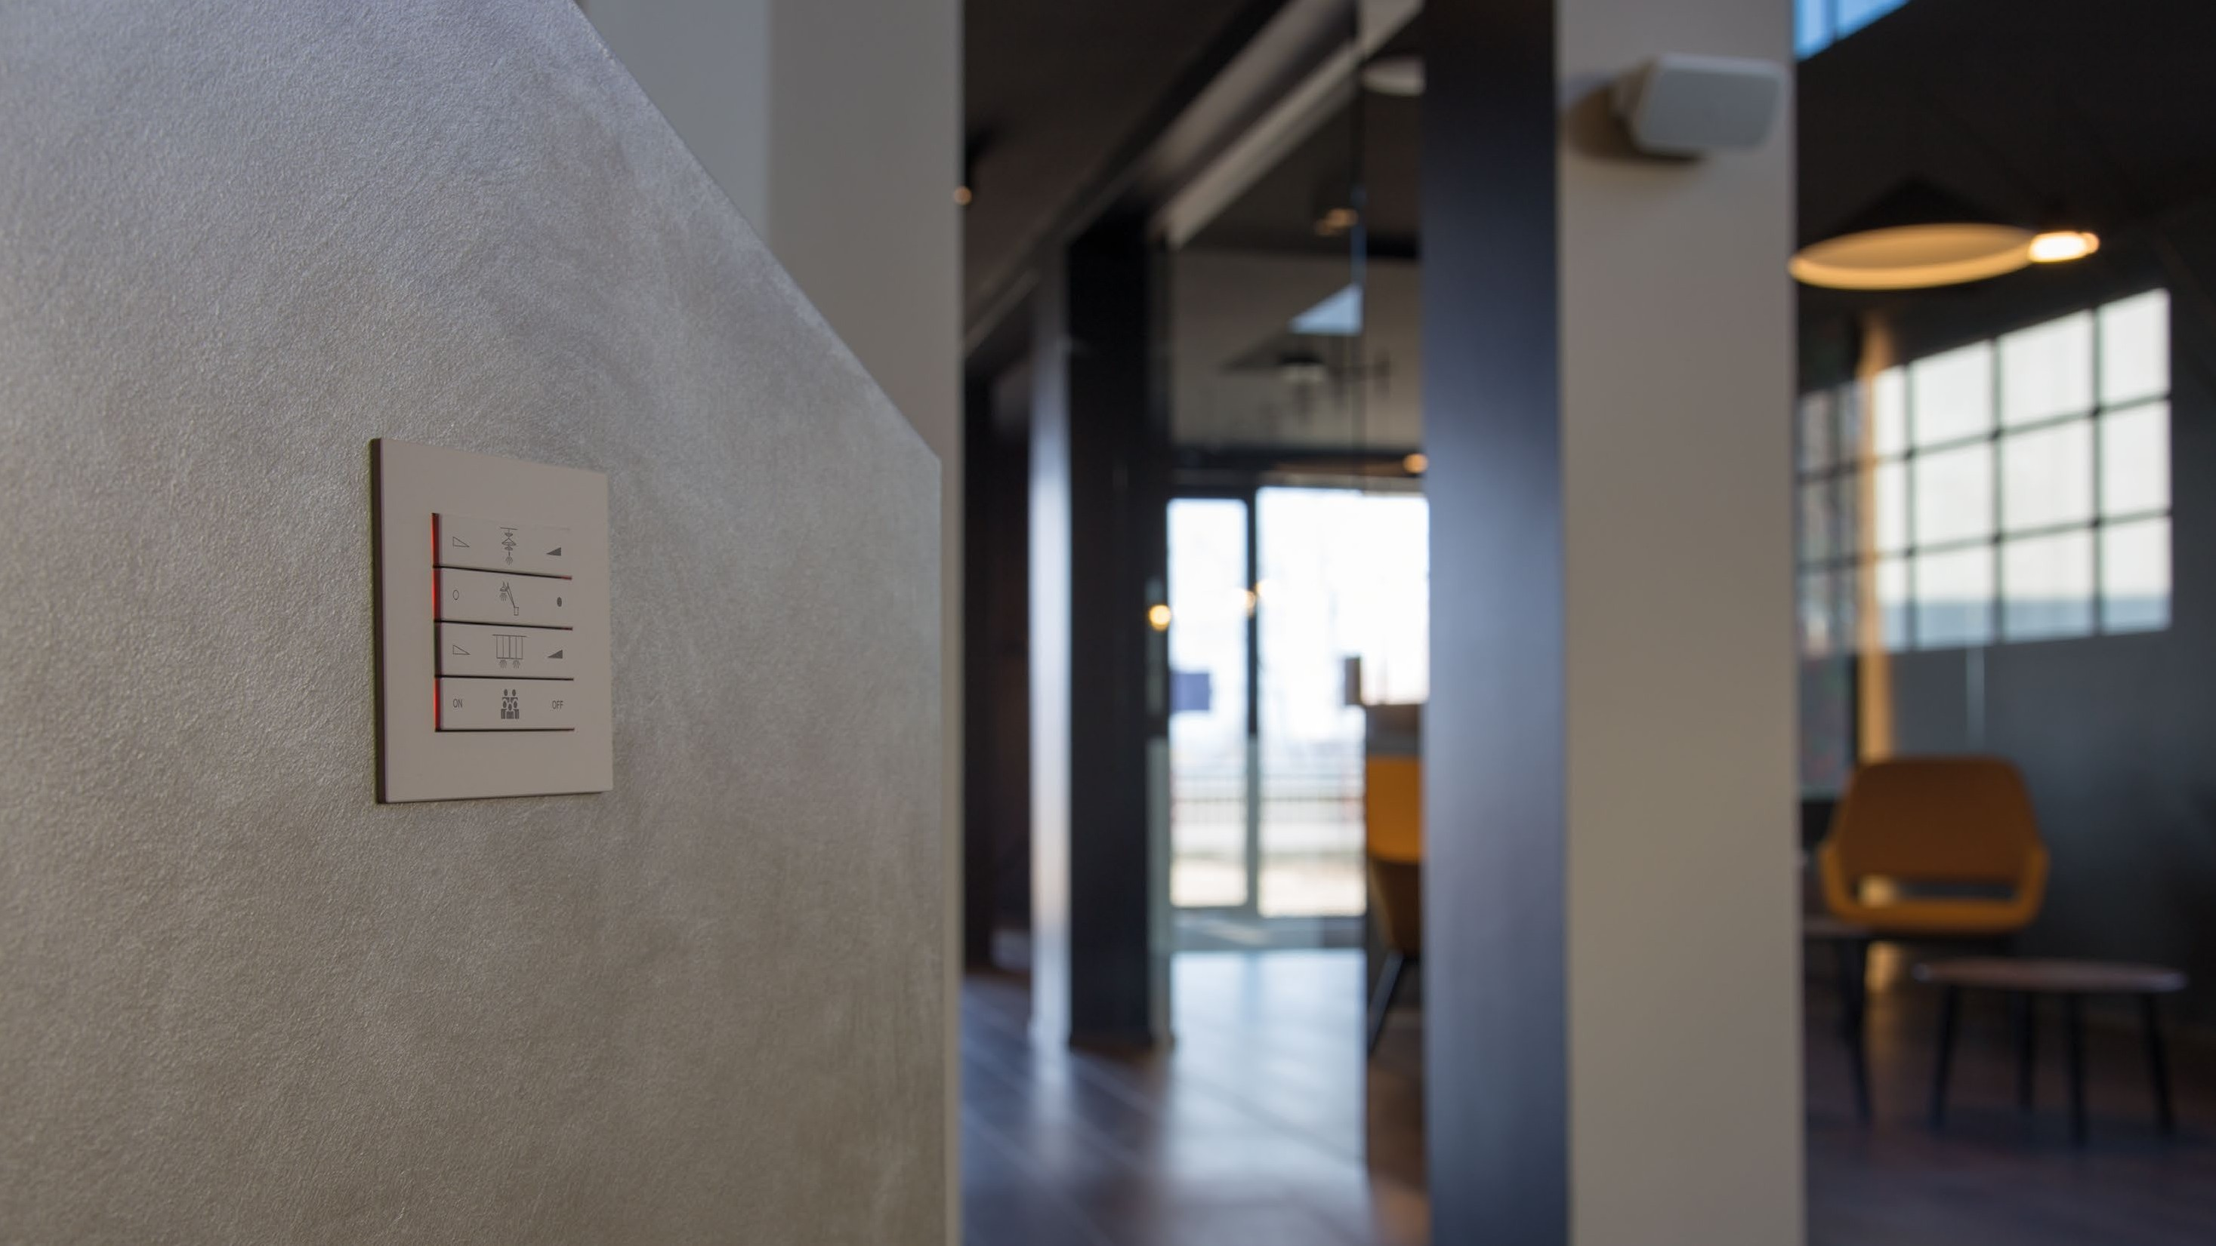
Thank you for you attention !

